Slide 1

Digital Portfolio
STUDENT NAME: Poovesh prasath R
REGISTER NO AND NMID: 2426j0112.asbruap2426j0112
DEPARTMENT: INFORMATION TECHNOLOGY
COLLEGE: PPG Collage of Arts and Science,Bharathiar university
1
Notes:
1

Slide 2

PROJECT TITLE
SIMPLE PORTFOLIO
2

Slide 3



AGENDA
Problem Statement
Project Overview
End Users
Tools and Technologies
Portfolio design and Layout
Features and Functionality
Results and Screenshots
Conclusion
Github Link
3/21/2024 Annual Review
3

Slide 4

Problem Statement
Many students and professionals need a simple, clean online presence to showcase their skills, projects, and contact information. The challenge is to create a lightweight, easy-to-maintain portfolio website that highlights the developer’s background and work using basic web technologies.
4

Slide 5

PROJECT OVERVIEW
The goal of this project is to build a personal portfolio website for poovesh prasath a B.Sc. Computer Science student. The website will display Poovesh prasath’s background, skills, and projects and provide a contact form for visitors to reach out. The project uses only HTML, CSS, and JavaScript to create a responsive, user-friendly site.
5

Slide 6

WHO ARE THE END USERS?
End Users
Potential employers or recruiters looking for Poovesh prasath’s skills and projects.
Friends, classmates, or professional contacts who want to learn more about Poovesh prasath s work.
Anyone interested in web development who might benefit from seeing a simple portfolio example.
6

Slide 7

TOOLS AND TECHNIQUES
Tools and Technologies
HTML: To structure the content of the website.
CSS: For styling and layout, ensuring the site looks clean and professional.
JavaScript: To add interactivity, such as form validation and user feedback.
Browser: To view and test the website locally.
Text Editor (like VS Code, Sublime Text): To write and edit code.
7

Slide 8
POTFOLIO DESIGN AND LAYOUT
Portfolio Design and Layout
Header: Contains Poovesh prasath’s name, degree, and navigation menu linking to sections (About, Projects, Contact).
About Section: Brief introduction about Poovesh prasath and his passion for web development.
Projects Section: A showcase of simple projects to demonstrate coding skills.
Contact Section: A form where visitors can send messages directly (with basic validation).
Footer: Displays copyright info.
Responsive Layout: The site is centered with a max-width to keep content readable and spaced well.
Color Scheme: Dark header/footer with light content area for contrast and readability.
Clean and Minimalist: Focus on content without distractions.
8

Slide 9
FEATURES AND FUNCTIONALITY
Features and Functionality
Navigation Menu: Smooth and easy to access sections of the page.
About Me Section: Static text introducing POOVESH PRASATH
Projects Section: Lists multiple projects with titles and descriptions.
Contact Form:
Input fields for name, email, and message.
Validation to ensure all fields are filled before submitting.
JavaScript alert confirms successful message submission.
Form resets after submission.
Responsive Design: Works well on desktop and smaller screens.
Consistent Styling: Uses CSS for layout, colors, fonts, and hover effects on buttons.
User Feedback: Alerts provide simple interaction feedback.

Slide 10
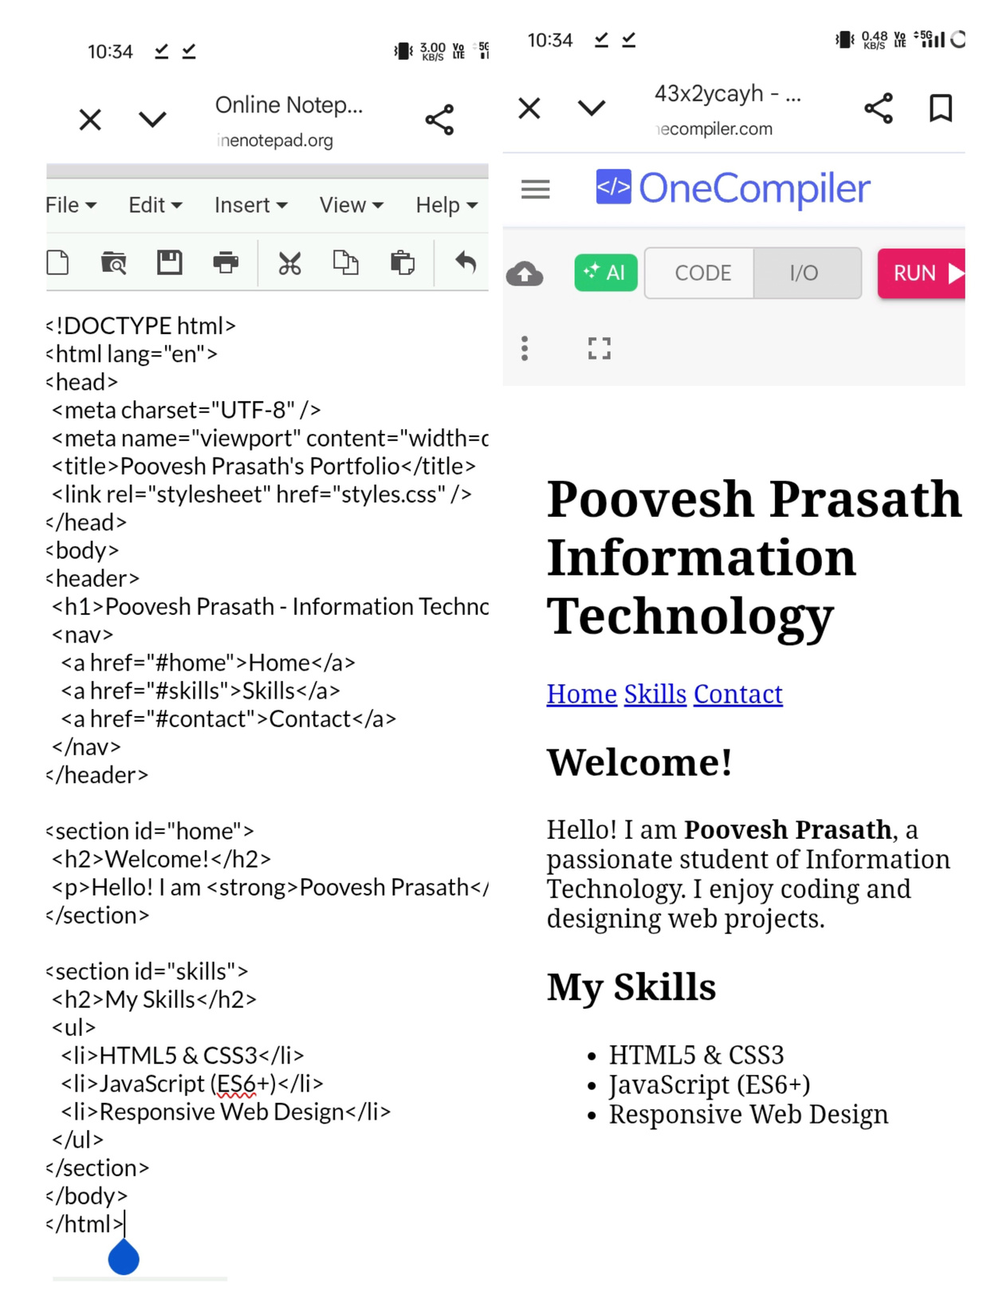

RESULTS AND SCREENSHOTS
3/21/2024 Annual Review
10

Slide 11
CONCLUSION
This portfolio website project successfully demonstrates the ability to build a clean, responsive, and functional personal website using only HTML, CSS, and JavaScript. It provides a solid foundation for showcasing skills and projects for potential employers or contacts.
11

